Slide 1
BIA 686 Project
Vijay Sarathy

Slide 2
Outline
Background, Methods, & Results of what has been done before (slides 3-6)
What is being done now (slides 7-8)
Results (slides 9-11)
Recommendations (slide 12)
Notes:
I added color coded margins to each slide to indicate the corresponding part (1-4).

Slide 3

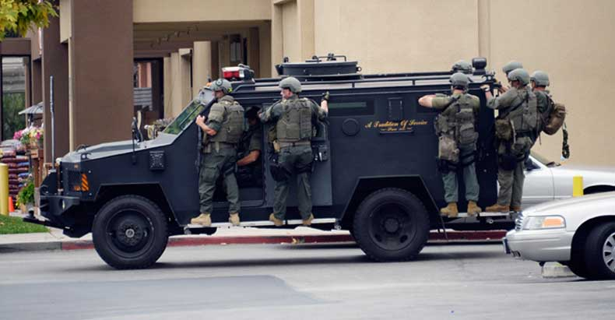
Background
Given the time and location:
Can the category of the crime that occurred be predicted?
And how fast can it be done?
SF Police Response Goal: 4 minutes

Slide 4
Previous Feature Engineering
Seasonality of Crime:
Week Day, Week of Year (1-52), Year
Distance of Crime:
X,Y decimal coordinates truncated to loosen precision to 110 m
Algorithm used
Naive Bayes
Random Forest
Data source: Kaggle, https://www.kaggle.com/c/sf-crime/data

Slide 5
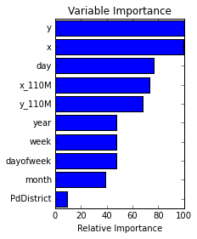
Previous Results
Precise location is the most important, followed by day and 110m approximations of the location
Naive Bayes - test error is 33.9%
Random Forest - test error is 33.5%
Random Forest was selected as the choice algorithm
Kaggle submission was ranked 201st/2335
RF algorithm can be run under 40 seconds in AWS

Slide 6
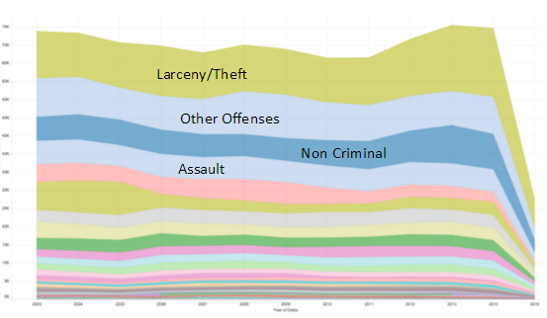
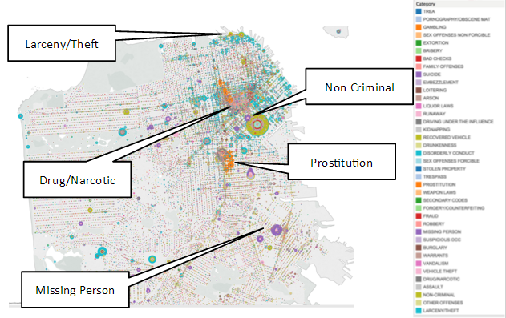
Previous Visualization of Training Data
The prevalent crimes are as follows: Larceny/Theft, Other Offences, Non Criminal, and Assault.

Slide 7
Research Questions
What are the common types of crime being predicted?
What are the misclassifications that usually occur?
How do varying splits of the train and test data (i.e. 80/20, 90/10) compare to the split performed (70/30)?
What are the optimal parameters of Random Forest?

Slide 8
Current Goals
Visualize results of test dataset with Tableau using Random Forest and Naïve Bayes
Perform Sensitivity Analysis of Random Forest algorithm using Hadoop YARN Pyspark

Slide 9
Test Data: Random Forest
The prevalent crimes are Larcency/Theft, Other Offences, Drug/Narcotics, and Vehicle theft.
Assault is present at some degree (blue patches in right map).

Slide 10
Test Data: Naive Bayes
The prevalent crimes include the following: larceny/ theft, other offences, assault, and drug/narcotics.

Slide 11
Sensitivity Analysis of Random Forest Parameters
Number of Trees | Training Error
10 | 0.336641853
20 | 0.329197684
50 | 0.325889165
Split | training error
60-40 | 0.50531401
70-30 | 0.329197684
80-20 | 0.19092219
90-10 | 0.087397087
Maximum Depth | Train Error
5 | 0.332506
10 | 0.336642
20 | 0.346567
Higher ratios of train to test data yield significantly higher accuracies,
increasing the number of trees slight improves accuracy.

Slide 12
Conclusions and Recommendations
Use 20 trees in Random Forest
Focus on addressing larceny/theft, assault, other offences, and drugs/narcotics.
The ratio between the size of the train dataset to the test dataset should be maximized, ideally 90/10.
The amount of predicted crimes is being overestimated (non criminal offenses show up less frequently with respect to the training set); this is good from a prevention standpoint but overuses resources.

